Slide 1
Git, github, and Docker
Developing Portable, Tracible, Reproducible Bioinformatic Pipelines

Slide 2
AGENDA Day 3
How The Internet Works… Sort Of
Review Specs For Our RPSLS Project
Design Our Project And Split Into Teams
Make Updates To Our Requirements And Container
Create Project Packages And Functions As Teams
Review Results And Set Version 2.0
Talk About Other Potential Extensions

Slide 3
Introduction
REST has become a standard interface for requesting data from an online resource. Using REST interfaces and similar APIs online can make obtaining data significantly easier than many other methods.

Slide 4
The HTTP Request
Probably the most common type of request sent over the Internet

Slide 5
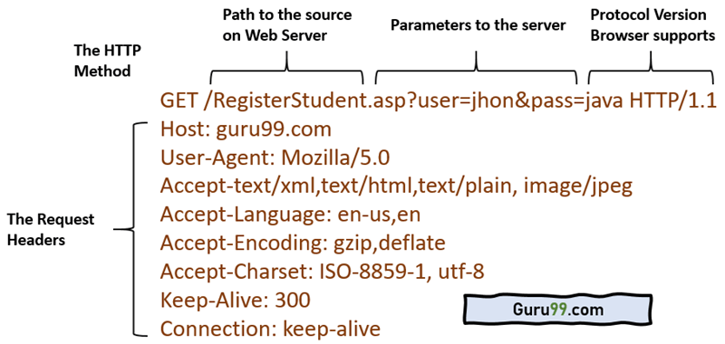
Some commands have 2 parts

Slide 6
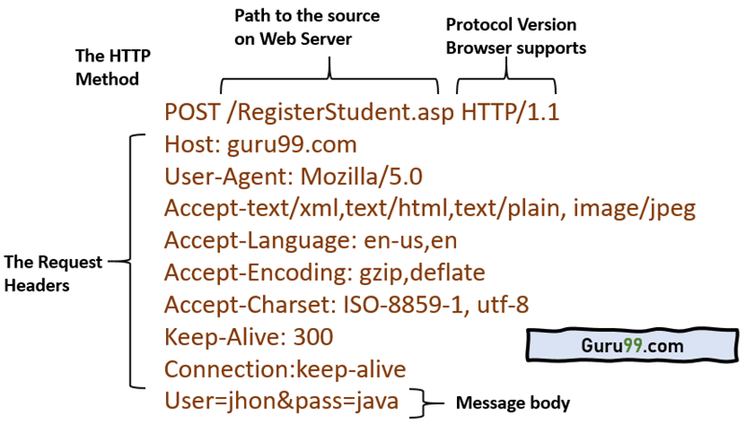
Some have 3 parts

Slide 7
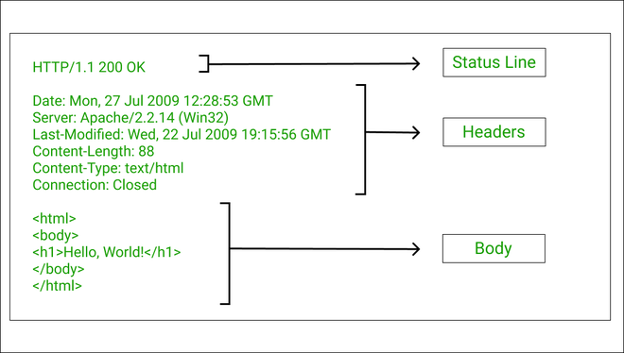
A good response will have 3 parts

Slide 8
Representational State Transfer
Designed to work over networks (even local or internal ones)
Follows the typical networking paradigm of client/server
Not a strict protocol, more of a concept
Uses HTTP request/response architecture to request and receive data with URL/URI to identify and provide a path to the endpoint

Slide 9
How it works
A REST system should be as stateless as possible
It should not remember and use a client’s previous requests when generating a response to a new one
Client makes a request
http://labdata.net/results/39
results/39 may be the endpoint, but most likely the code is looking for the results portion as the endpoint and the 39 is treated more like a numerical sample key
Server responds by taking appropriate action when a request for a result number arrives.
Data will frequently be returned in XML or JSON formats these days

Slide 10
Basic data operations
CRUD paradigm… all the things you can do with data
Create: Store a new entry
Read: Return the value(s) associated with an identifiable entry
Update: Change the value(s) associated with an identifiable entry
Delete: Remove an entry
Compare to HTTP request verbs
Get: Similar to read. HTTP request has no body for data
Post: Similar to create. Post can have a body
Put: Simialr to update
Delete: Self-explanatory
Developer gets to decide how the verbs are interpreted

Slide 11
The Python Decorator
The Python decorator always starts with an “@” symbol and modifies the function or object below it
Calls another function on the immediate output of the modified function
@app.get("/rps", response_class=fastapi.responses.HTMLResponse) def sendRPSPlayPage(request:fastapi.Request): return templates.TemplateResponse("play.html", {"request":request, "id": "rps", "game": "Rock, Paper, Scissors", "throws": list(RPSWINS.keys())})

Slide 12
Today’s coding
Rock, Paper, Scissors, Lizard, Spock

Slide 13
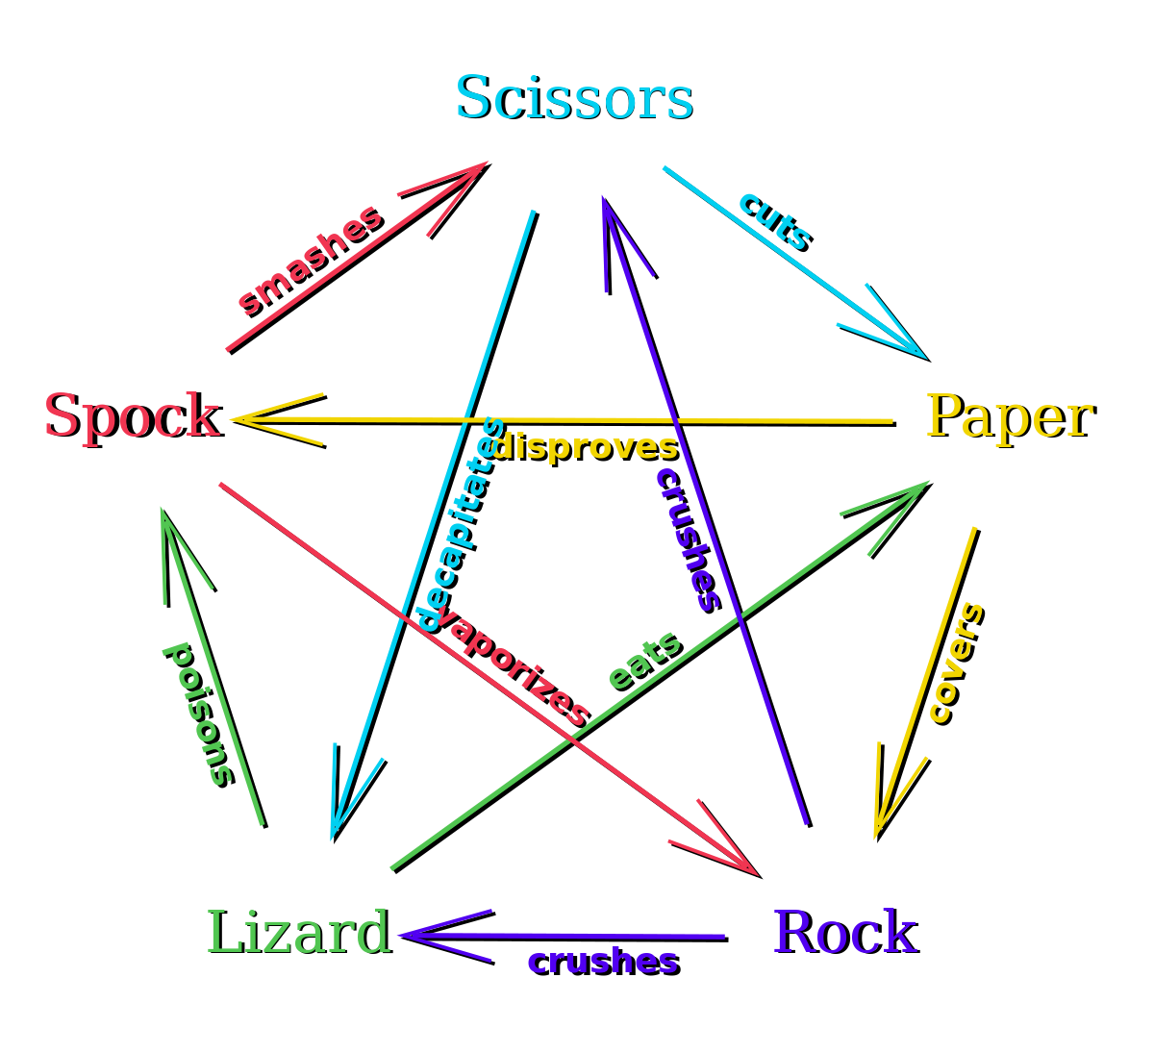
The new ruleset

Slide 14
Making the RPS program
How will the new rules affect our code?
It is possible that the rules are generalized enough that adding new ones does not affect anything but the source data
How can we run this through a browser?
How do we get the player’s throw?
How do we get the computer’s throw?
What do we need in our environment?

Slide 15
THANK YOU
Please contact me with any questions you may have.

